Slide 1
CBDCs – Central Bank Digital Currencies

Slide 2
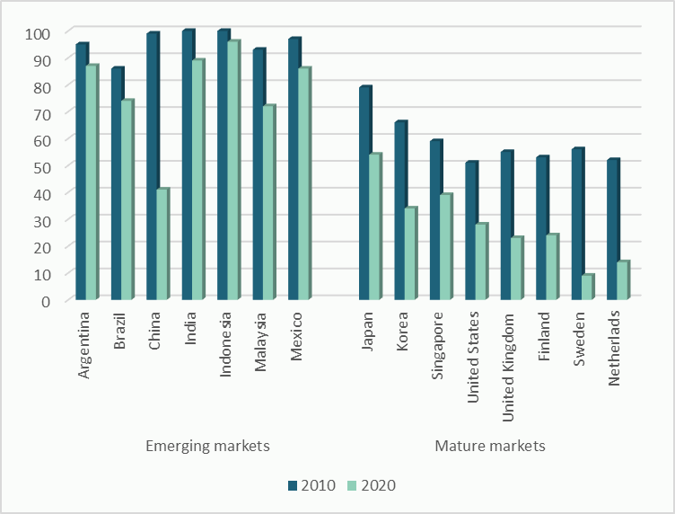
Introduction
With the rise of cashless payments, exacerbated by the COVID -19 pandemic, many central banks are exploring the development of Central Bank Digital Currencies (CBDCs) to keep up with the digitalization of the economy.
In this presentation you will find:
What are CBDCs?
Benefits and threats;
Effects on monetary and fiscal policy;
International comparison.
Cash usage by country Percent of cash used in total transactions by volume, %
Sources: McKinsey, The 2020 McKinsey Global Payment Report

Slide 3
What are CBDCs?
A CBDC is a virtual money backed and issued by a central bank.
Digital
Central bank issued
Widely accessible
Token-based
CB reserves and settlement accounts
Bank deposits
The "money flower" is often employed to help define CBDCs relative to other forms of money.
CB accounts (general purpose)
CB digital tokens
(wholesale)
It concentrates on the interactions of four primary components:
Issuer
Form (digital or physical)
Accessibility (general or restricted)
Technology (token or account-based)
CB digital tokens (general purpose)
Private digital tokens (wholesale)
Cash
Private digital tokens (general purpose)
Sources: BIS, Cointelegraph

Slide 4
What are CBDCs? - Features
According to the previous taxonomy, CBDCs are classified in three types:
Token-based
Each token has a specific denomination, therefore verification depends on the validity of the means used to pay.
General purpose ①: the CBDC is available to the general public for all transaction relating to the purchase of goods and services.
Wholesale ②: the CBDC is used by financial institutions for bank-to-bank transactions and settlements
Account-based
Account-based CBDC ③: the central banks verify the identities of the two parties involved in the process.
​The truly revolutionary innovation currently under discussion is the issuance of a general-purpose CBDC.​
For the "digital money" we can currently access using cards or mobile apps, the liability is held by a bank or other financial institution.
In the case of a CBDC, the liability rests with the central bank.
Source: Cointelegraph, Atlantic Council

Slide 5
Benefits of CBDCs
Financial inclusion
If properly adopted, CBDC could foster financial inclusion by providing easy and safer access to money for unbanked and underbanked populations.
Faster and cheaper payments
The introduction of a CBDC could significantly reduce the time and costs to successfully complete a transaction, particularly cross-border payments.
Also, merchants and consumers may be attracted by fully digital payment processes with lower transaction fees and faster settlement.
Better money traceability
When transactions move from highly regulated financial systems into alternative platforms, they enter a legal grey area where normal standards of consumer protection do not apply. With the introduction of CBDCs, central banks could prevent that.
Shift towards a cashless society
Issuing CBDCs could ensure that sovereign money continues to play its role a highly digitalized economy.
Sources: ECB, Fabio Panetta: More than an intellectual game: exploring the monetary policy and financial stability implications of central bank digital currencies

Slide 6
Potential threats
Excessive government control
With a banking system based on CBDCs central governments could be able to control or block any kind of transaction and freeze individual accounts.
Hacking risk
Similar to centralized blockchains all the keys and data are held in one single place generating a high cybersecurity risk. A single successful hack from a rival government with a powerful cyber warfare team may be devastating in the case of a state government keeping a large part of its national economy locked in one centralized place.
Centralization of data
One of the main issues of CBDCs that may come up is related to the amount of data that governments could obtain. They will have access to an unprecedented amount of financial data, which might have serious implications for those considered a danger to the state.
Sources: ECB, Fabio Panetta: More than an intellectual game: exploring the monetary policy and financial stability implications of central bank digital currencies

Slide 7
Monetary and fiscal policy
Effects on monetary policy
How would the CBDC rate affect the pass-through of more traditional monetary policy instruments, such as the interest on reserves?
A remunerated CBDC could strengthen monetary policy transmission: changes in remuneration would immediately affect households and force banks to adjust their deposit rates more quickly to avoid large shifts in their depositor base.
Problem: If a CBDC were issued without safeguards to constrain its use, it could pose risks to bank intermediation by crowding out bank deposits and payment activities. Some potential solutions could be to establish a cap on CBDC holding or to make remunerations on CBDC holding less attractive over a certain threshold.
According to the ECB, using the digital euro as a monetary policy tool is not a motivation for its issuance.
Effects on fiscal policy
A tighter control of transactions could improve central banks’ ability to fight money laundering and tax evasion, at the same time reducing the size of a country’s informal economy.
Source: Fabio Panetta: More than an intellectual game: exploring the monetary policy and financial stability implications of central bank digital currencies For a more comprehensive reading, see: Jiang, J. and Zhu, Y. (2021), Monetary Policy Pass-Through with Central Bank Digital Currency

Slide 8
5. International comparison
105 countries, representing over 95 percent of global GDP, are exploring a CBDC.
Authors' elaboration from Atlantic Council "Central Bank Digital Currency Tracker"
Source: Atlantic Council

Slide 9
International comparison – The Bahamas
It is an undertaking to promote more inclusive access to regulated payments and other financial services for unbanked and underbanked communities and socio-economic groups within the country.
Objectives
Stakeholders
involved
Central Bank of bahamas; OMNI financial services: sun cash, cash n'go, moneymaxx, kanoo pays.
The Sand Dollar is the world's most advanced 'official' digital currency. The Sand Dollar holds identical legal status as the standard currency, is issued by authorized financial institutions, and can be used for a variety of transactions.
Development
stage
The Sand Dollar is the digital version of the Bahamian dollar (B$). It is available for both wholesale and retail applications. The wholesale application would ordinarily restrict usage to payments settlements at the inter-bank level, akin to clearing house transactions. The proposed retail application would also allow the general public to make and receive digital payments.
Structure
Source: Atlantic Council

Slide 10
International comparison – China
Boosting the yuan’s relatively low use outside of the Chinese domestic market; Limit the power and market share of both commercial banks and digital payment corporations that operate independent of the state.
Objectives
Stakeholders
involved
Alipay, WeChat Pay, TenPay, People’s Bank of China.
Development
stage
China's central bank is to extend the trial of its e-CNY digital currency to four major provinces including Guangdong. 2022 also saw the e-CNY’s highly anticipated trial launch at the 2022 Winter Olympics – the first of such trials to include foreign visitors.
E-CNY users can choose between individual or corporate wallets, which offer different transaction limits. Wallets can also be software based — the e-CNY mobile app, which allows users to manage their e-CNY transactions — or hardware based, an electronic card that allows for touch-based transactions.
Structure
Source: Atlantic Council

Slide 11
International comparison – Europe
It would be a central bank digital currency, an electronic equivalent to cash. And it would complement banknotes and coins, giving people an additional choice about how to pay. Efficient and secure payment system is the basis for our economies to function effectively.
Objectives
Euro Retail Payments Board, Digital Euro Market Advisory Group, Eurosystem national central banks European Commission.
In September 2022, the ECB announced that it would be partnering with Caixabank, Worldline, Amazon, EPI and Nexi.
Stakeholders
involved
Development
stage
Kicked off the investigation phase a year ago. Just entered the second year of the investigation phase of our digital euro project.
The ECB is set to begin a pilot of the digital euro in 2023.
Source: Atlantic Council, ECB

Slide 12
International comparison – USA
Objectives
It is an undertaking to promote more inclusive access to regulated payments and other financial services for unbanked and underbanked communities and socio-economic groups within the country.
Stakeholders
involved
Federal Reserve Bank of New York, the Federal Reserve System, Treasury Department, market regulators, and federal banking supervisors, CMPI, Bank for International Settlements.
Development
stage
The Federal Reserve Board has issued a discussion paper that examines the pros and cons of a potential U.S. CBDC. The Federal Reserve Bank of Boston in collaboration with MIT's Digital Currency Initiative conducted research project (Project Hamilton) to investigate the technical feasibility of a general purpose CBDC.
Source: Atlantic Council, Federal Reserve Bank of Boston

Slide 13
Authors
Project Lead
Alberto Martini
Second-year BSc student in International Economics and Finance.
Interested in innovation in the financial sector and constantly looking for opportunities to grow and learn.
Junior Analysts
Aniello Renzullo
Maria Tatarchernko

