Slide 1
Blockchain and cybersecurity

Slide 2
Frauds and cyberattacks
Taking the right security measures, when connected, is the key to prevent cyber intrusions and online crimes.
Cyber frauds are crimes committed via a computer with the intent to corrupt another individual’s personal and financial information stored online
Identity theft is the act of fraudulently making use of the electronic signature, password, or any other unique identification feature of any other person.
Ransomware is a type of computer malware that encrypts the files and storage media on communication devices like desktops, laptops, mobile phones, etc., holding data as a hostage. The victim is asked to pay the demanded ransom to get his device decrypted.
Phishing is a type of fraud that involves stealing personal information such as Customer ID, IPIN, Credit/Debit Card number, CVV number, etc. through emails that appear to be from a legitimate source
A Trojan horse is a destructive program that looks like a genuine application. Unlike viruses, Trojan horses do not replicate themselves, but they can be just as destructive. Trojans open a backdoor entry to your computer which gives malicious users/programs access to your system, allowing confidential and personal information to be stolen.
Sources: clearias
July 14, 2022

Slide 3
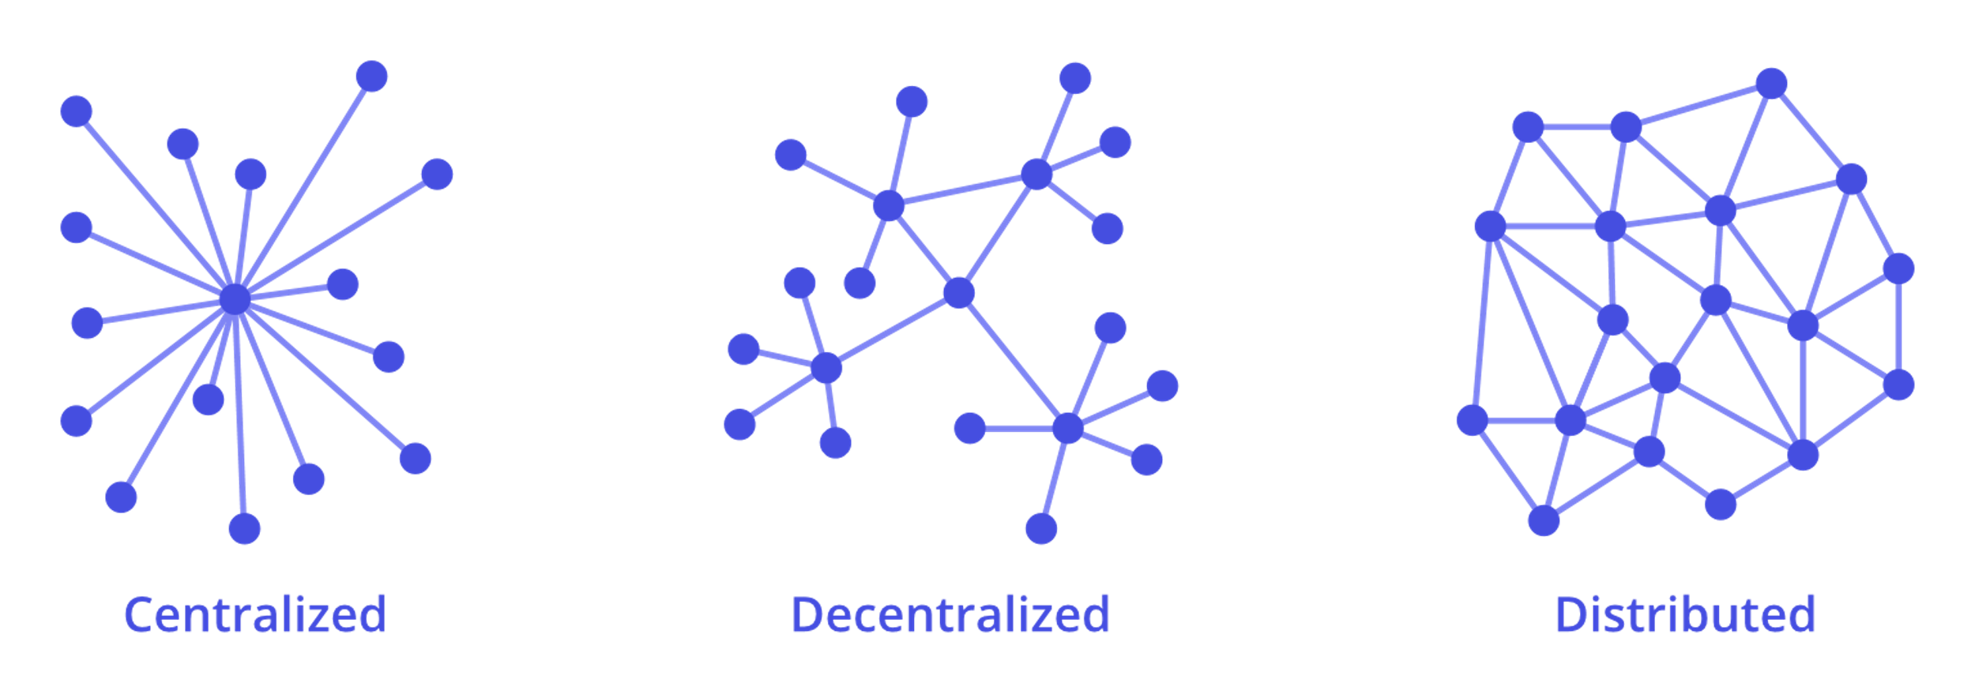
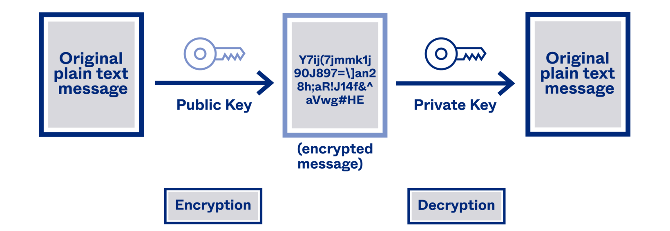
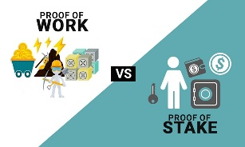
What is a blockchain?
Blockchain technology is becoming increasingly important in several industries that require a new model of data storage .
The blockchain is a network-distributed ledger, which relies on a decentralized database structured in blocks, each containing a certain amount of information and assembled in a unique chain
The blockchain keywords are:
Distributed network: data is constantly shared and synchronized across nodes. Any change made to the network is automatically mirrored in all its copies.
Decentralized consensus: it is a mechanism that allows information to be shared between two nodes without having to transit through a central entity to validate the content.
Cryptography: data saved on a blockchain is never immediately decipherable, in order to guarantee their fruition to legitimate users only.
"The Blockchain Journey" of Salviotti, De Rossi, Abbatemarco
July 14, 2022

Slide 4
Blockchain role and challenges in cybersecurity
Cyberattacks are increasing in an exponential way daily and old defense ways may not be enough anymore.
Problems | Blockchain solutions
Weak passwords protect large quantity of data. These have an end to end type of cryptography. Hackers could easily access sensible data. | Blockchain technology can be used to develop a standard security protocol (safer then the common one) and can protect private messaging by enabling a cross-messenger communication with a unified API framework.
Hackers through edge devices (smart switches) can gain access to smart homes’ systems because of their dodgy security. | They decentralize the administration so they can secure better the systems.
A hacker simply needs to exploits a single vulnerable point in the data system to access sensible data such as business financial records. | By using blockchain, sensitive data may be protected by decentralizing it making life tough for the hacker.
Not authorizes third parties gain access to data while it transits from a server to another. | Blockchain technology uses encryption to protect this data from unauthorized third parties.
Human error. | This technology has the highest standards of integrity and transparency.
Sources: Forbes and itbusinessedge
July 14, 2022

Slide 5
DDOS attack
Sneaky frauds that can last only a couple of minutes are the real damage for all companies, DDoS is becoming the most threatening one.
Money talks
What is it?
A DDoS attack can cost a company over $1.6 million
Companies can lose $20.000 per hour
Cyber attack designed to take offline or shut down the traffic of a targeted server by flooding it with fake requests from malicious infected sources until it passes it’s maximum capacity.
At this point legitimate users can’t connect with the network, so it finishes in a distributed denial of service situation.
It’s main goal is to cut off users from servers but, it can be used as a “smokescreen” for other cyberattacks, like damaging a reputation or data theft.
It is difficult to recognize because the traffic of the malware created looks normal and so it is difficult to separate from the real traffic.
How does it work?
Botnets are created by hackers who exploits systems turning them in botmasters.
When enough serves/devices are infected with malware the hacker send specific instructions to each bot (for example a request to the server’s IP address) to carry out the attack.
The server is overloaded with requests and goes in a distributed denial of service.
An attacks can last for days or even weeks.
Source: cdnetworks
July 14, 2022

Slide 6
DDOS attack
Some types of DDoS attack
Type | Damage | Measuring the damage
Volume (UDP, ICMP) | Consumes bandwidth. Goal is to send as many request possible in the shorter time. | Bps rate. The higher they are the more effective it is.
Application(Zero day DDoS) | Cripple Apps directly. They attack the part of server that generated web pages so it is launched by https, https, dns or smtp. They seems legitimate HTTP requests. | Requests per seconds Based on how frequently hackers request access to the apps botnets.
Protocol(Smurf DDoS) | Attacks the network infrastructure by sending slow or malformed pings. The server cannot be protected by firewall because it goes through it. | Packets per second. It depend on the number of packets of information sent.
How to defend
Add filters to block requests from strange IP addresses
Limit number of login attempts
Web server configuration against DDoS attacks
Migrate public resources to another IP address
Disable any unneeded or unfamiliar network
Sources: kaspersky and cdnetwork
July 14, 2022

Slide 7
Case study: Amazon
Important companies are the cyberattacks' favourite victims. Here are two examples of threats that Amazon and Microsoft had to deal with.
Reflection attacks
Technique that is based on mutual authentication schemes in order to trick the target into revealing the secret shared between it and another valid user.
Amazon Attack
From 2018 to 2019 the attacks started to increase but still were of small dimension (1Tbps max), but smaller attacks can affect an application if the server isn’t DDoS resilient.
On February 17th , 2020, an attack of 2.3 Tbps by anonymous hackers hit AWS (Amazon Web Services) using a DDoS attack by a “reflection attack.”
Amazon was secured by AWS Shield (a service designed to protect customers of Amazon’s on-demand cloud computing platform from these attacks) that reported the use of hickjacked CLDAP web servers that threatened the precious data for 3 days.
Data talks
72% increase of monthly attacks from February to April 2020 between Q1 2020 and Q2 2020, we observed a 46% increase in the frequency of events that were detected on behalf of gaming applications
The most common attack that AWS Shield reported In 2020 was the web request flood
Sources: aws amazon
July 14, 2022

Slide 8
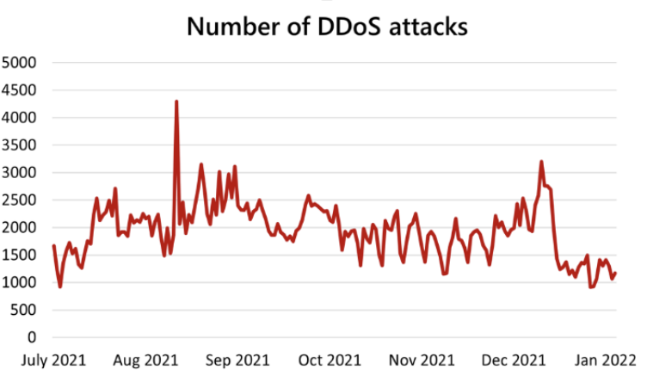
Case Study: Microsoft
Microsoft 2021 attack
Microsoft is struggling against many attacks every month.
An average of 1,955 attacks per day (40% more from the first months of 2021) are blocked by Microsoft.
In the second half of 2021, Azure (Microsoft’s protection platform) started to experience an unprecedented level of DDoS activity, the peak was reached on August 10th with a record breaking number of 4,296 attacks.
In November, Microsoft mitigated a DDoS attack with a throughput of 3.47 Tbps and a packet rate of 340 million packets per second, targeting an Azure customer in Asia.
In December, Azure mitigated two more attacks that surpassed 2.5 Tbps,both of which were again in Asia. One was a 3.25 Tbps attack in Asia. That went on for more than 15 minutes, the other attack was a 2.55 Tbps with one single peak, and it lasted just a bit over five minutes.
Sources azure microsoft
July 14, 2022

Slide 9
Authors
Project Lead
Sofia Leali
Project Leader
BSc International Economics and Finance student at Bocconi University.
Driven by challenges and innovation.
Junior Analysts
Alberto
Martini
Nicola
Cestra

Slide 10
November 14, 2021

